Slide 1

Hadoop Demo on IBM Cloud
Pooja Holkar
Technical Solutions Architect

Slide 2
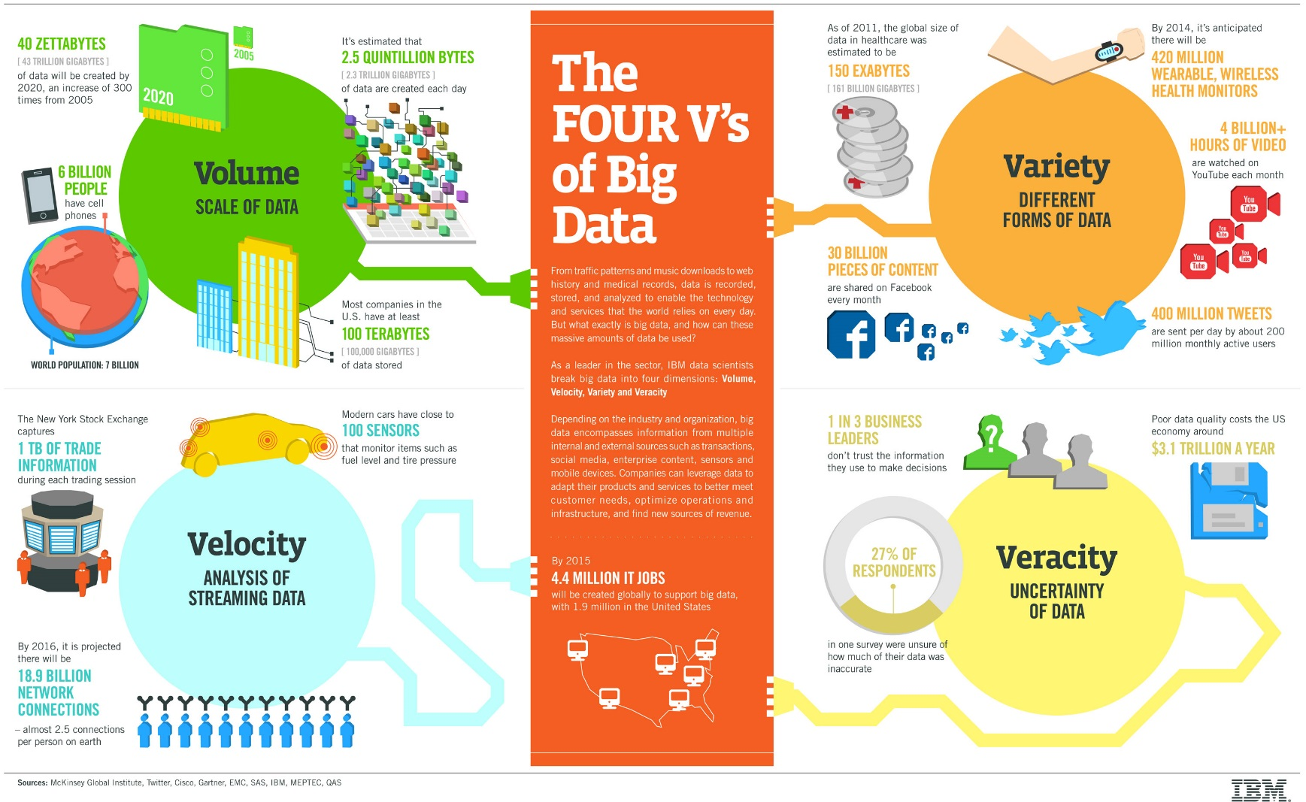
What is Big Data and Why Hadoop?

Slide 3
Introducing Big Data Continued
Internet of things
Social Sentiment
Wikis / Blogs
Exabytes
(10E18)
Sensors / RFID / Devices
Click Stream
Audio / Video
WEB 2.0
Log Files
Mobile
Petabytes
(10E15)
Advertising
eCommerce
Collaboration
Spatial & GPS Coordinates
Volume
ERP / CRM
Digital Marketing
Data Market Feeds
Terabytes
(10E12)
Search Marketing
Payables
Contacts
eGov Feeds
Payroll
Deal Tracking
Web Logs
Weather
Gigabytes
(10E9)
Inventory
Sales Pipeline
Recommendations
Text/Image
Velocity - Variety
ERP / CRM
WEB 2.0
Internet of things
Storage/GB
1980
190,000$
1990
9,000$
2000
15$
2010
0.07$

Slide 4
HOW DO ORGANIZATIONS USE BIG DATA?
LinkedIn: People you may know
AT&T: Patterns about usage and user movements
Amazon: Recommendations
MIT used location data from Macy’s parking lot to estimate Thanksgiving sales – before Macy’scould!
Anything homegrown??
•Aadhar project (Govt of India)

Slide 5
What is Hadoop?
Hadoop is an open source distributed processing framework that manages data processing and storage for big data applications running in clustered systems.
It is at the centre of a growing ecosystem of big data technologies that are primarily used to support advanced analytics initiatives, including predictive analytics, data mining and machine learning applications.
Hadoop can handle various forms of structured and unstructured data, giving users more flexibility for collecting, processing and analysing data than relational databases and data warehouses provide.

Slide 6
MAJOR COMPONENTS OF HADOOP
HDFS = Hadoop Distributed Filesystem: A file system for storing big datasets on a cluster; it makes the cluster look like it’s just one big disk. Behind the scenes, it replicates the data and protects against node failure.
MapReduce: a programming framework for parallel processing of data. mapreduce do two basic operations – reading data from the database, putting it into a format suitable for analysis (map), and performing mathematical operations i.e counting the number of males aged 30+ in a customer database (reduce).
YARN and the rest of the ecosystem: YARN manages resources of the systems storing the data and running the analysis and it allows other applications besides MapReduce to be executed within a Hadoop cluster.

Slide 7
Big data tools associated with Hadoop
Flume: a tool used to collect, aggregate and move huge amounts of streaming data into HDFS
HBase: a distributed database that is often paired with Hadoop
Hive: an SQL-on-Hadoop tool that provides data summarization, query and analysis
Oozie: a server-based workflow scheduling system to manage Hadoop jobs
Phoenix: an SQL-based massively parallel processing (MPP) database engine that uses HBase as its data store
Pig: a high-level platform for creating programs that run on Hadoop clusters
Sqoop: a tool to help transfer bulk data between Hadoop and structured data stores, such as relational databases
ZooKeeper: a configuration, synchronization and naming registry service for large distributed systems.
apache Solr: enterprise search engine
Spark: Spark is an alternative in-memory framework to MapReduce, Supports streaming, interactive queries and machine learning.
Kafka: distributed publish-subscribe messaging system and a robust queue that can handle a high volume of data.

Slide 8
GUI tools to manage Hadoop
Ambari: developed by HortonWorks.
HUE: developed by Cloudera

Slide 9
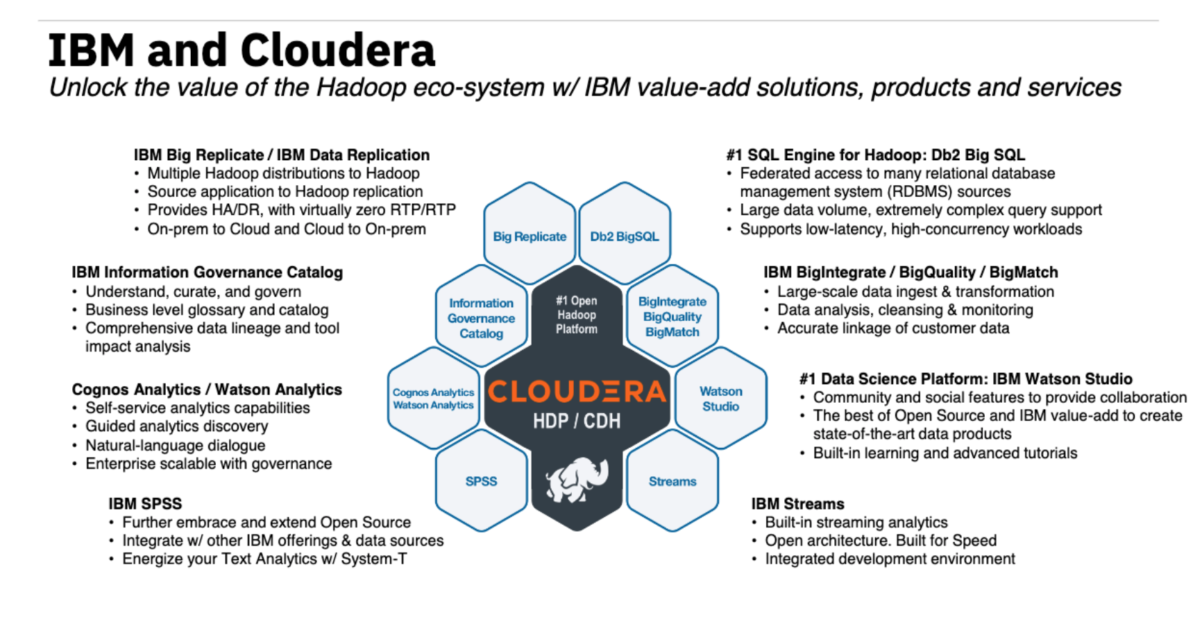
The IBM and Cloudera Ecosystem

Slide 10
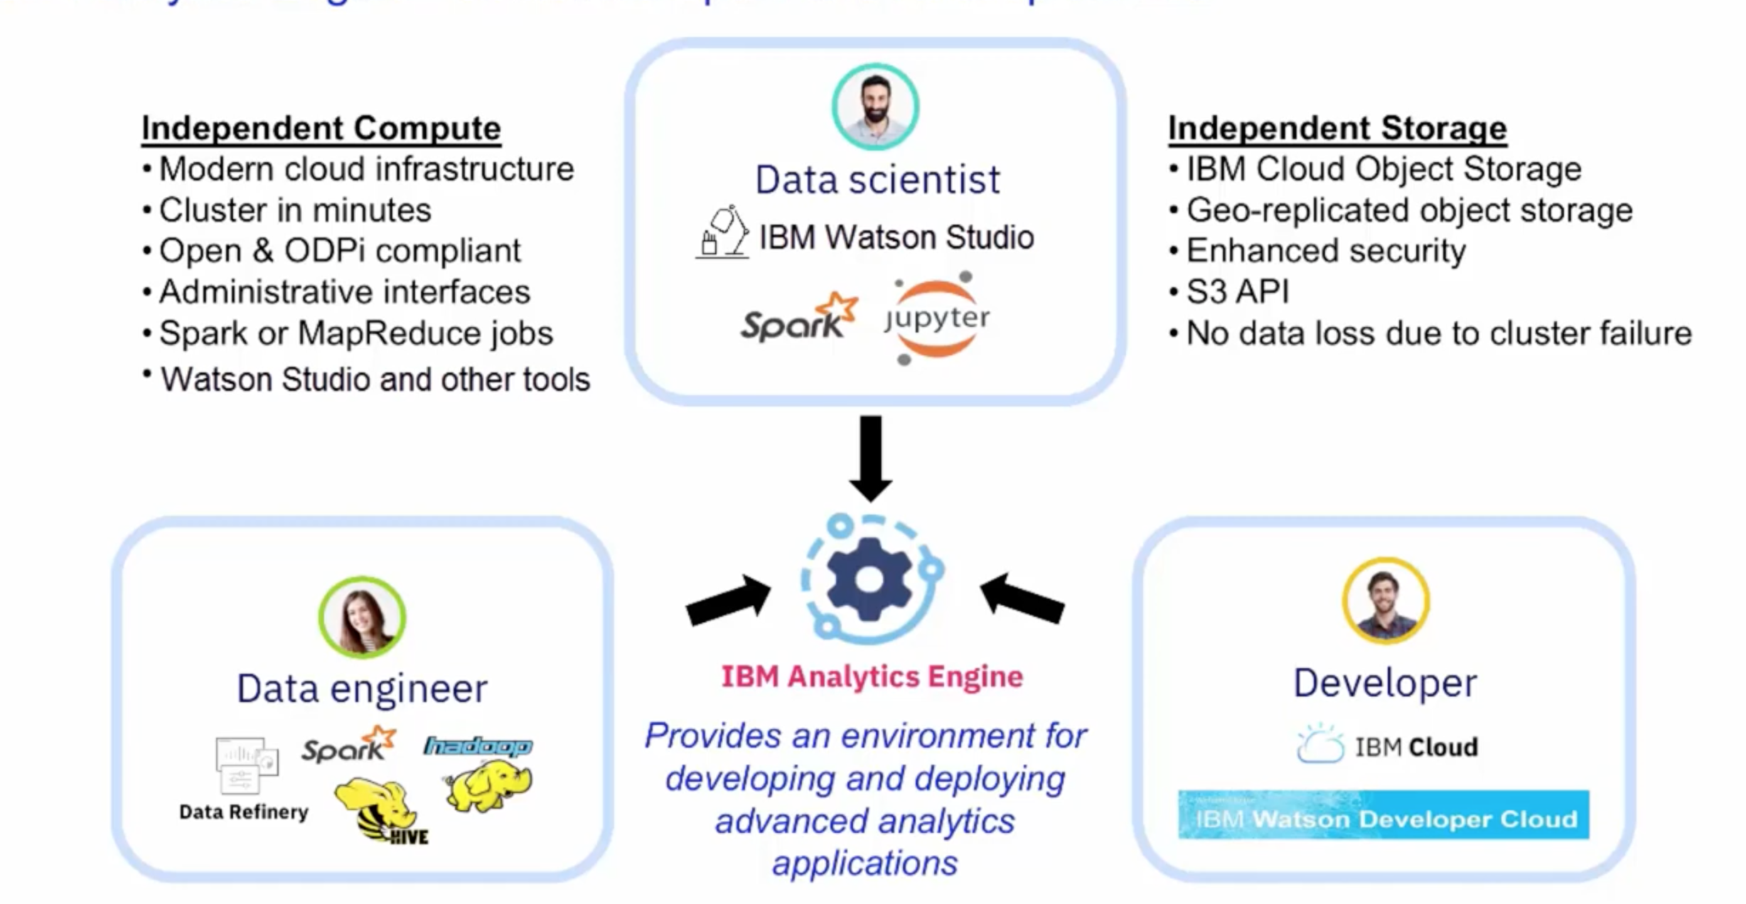
Working with IBM Analytics Engine

Slide 11
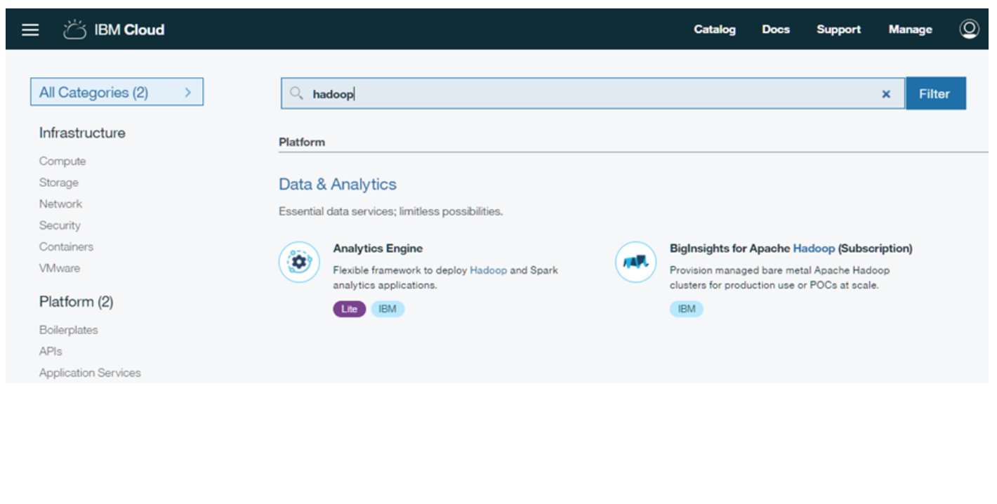
How to work with Hadoop on IBM cloud?

Slide 12
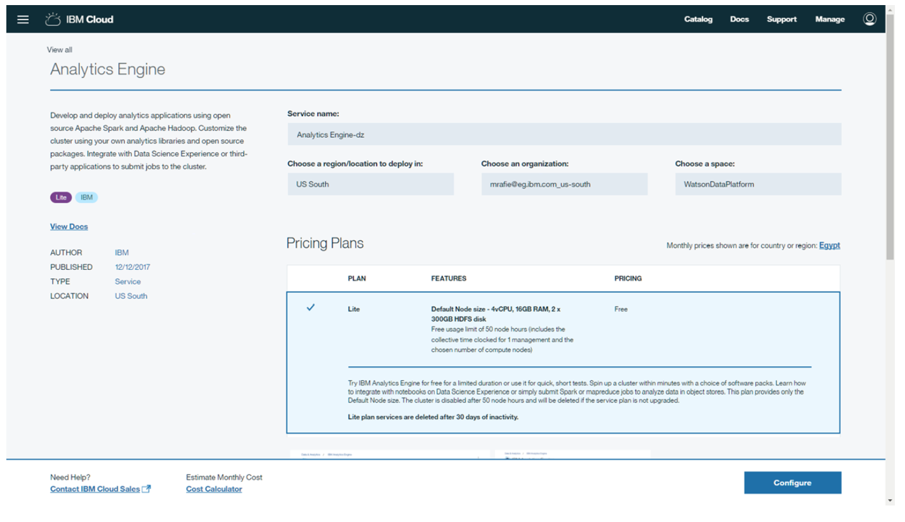

Slide 13
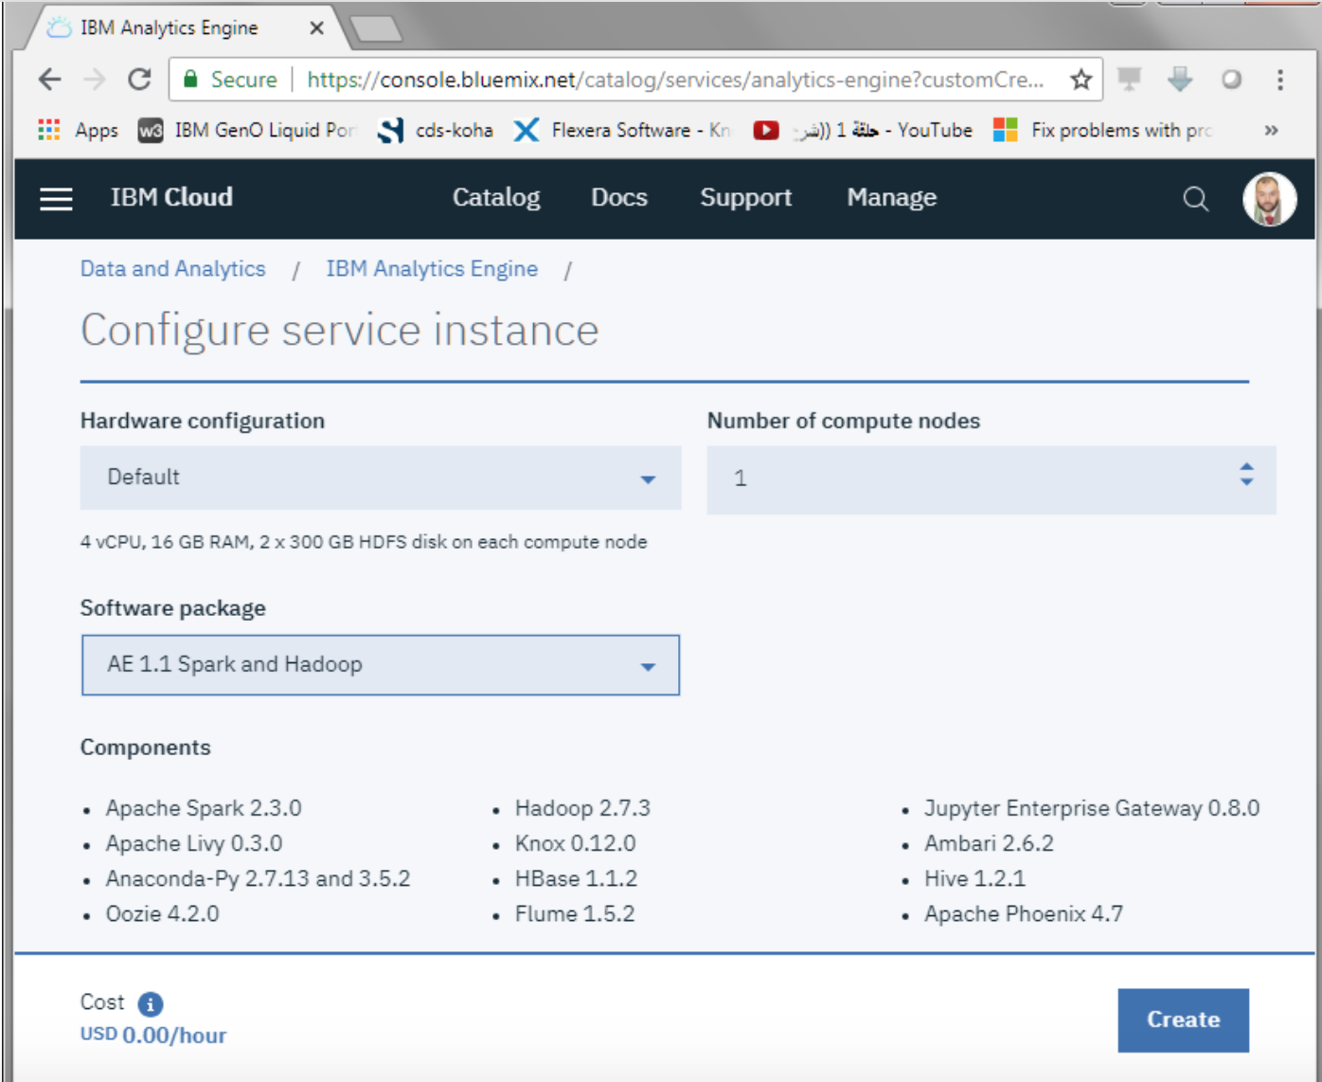

Slide 14
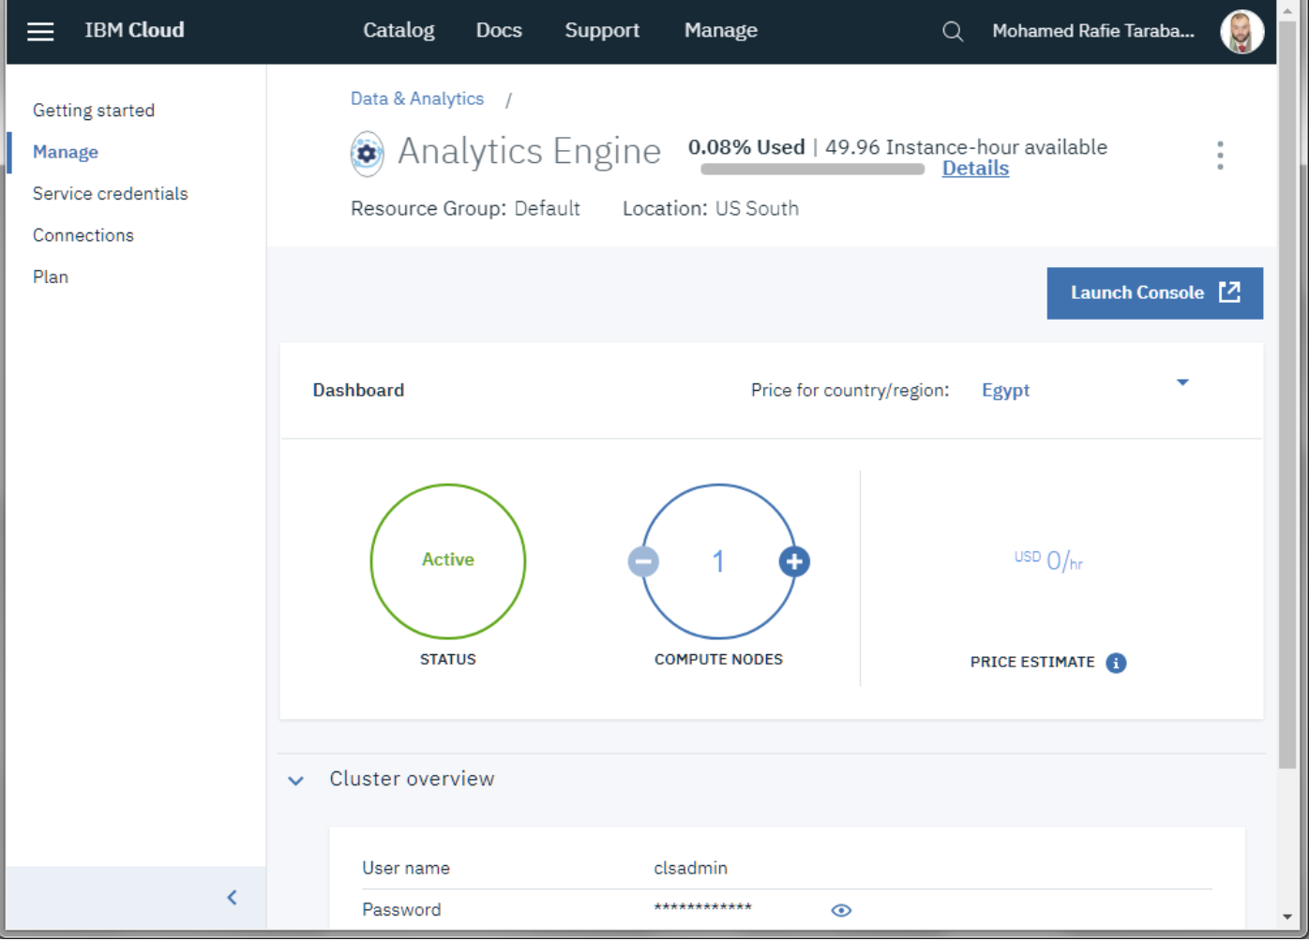

Slide 15
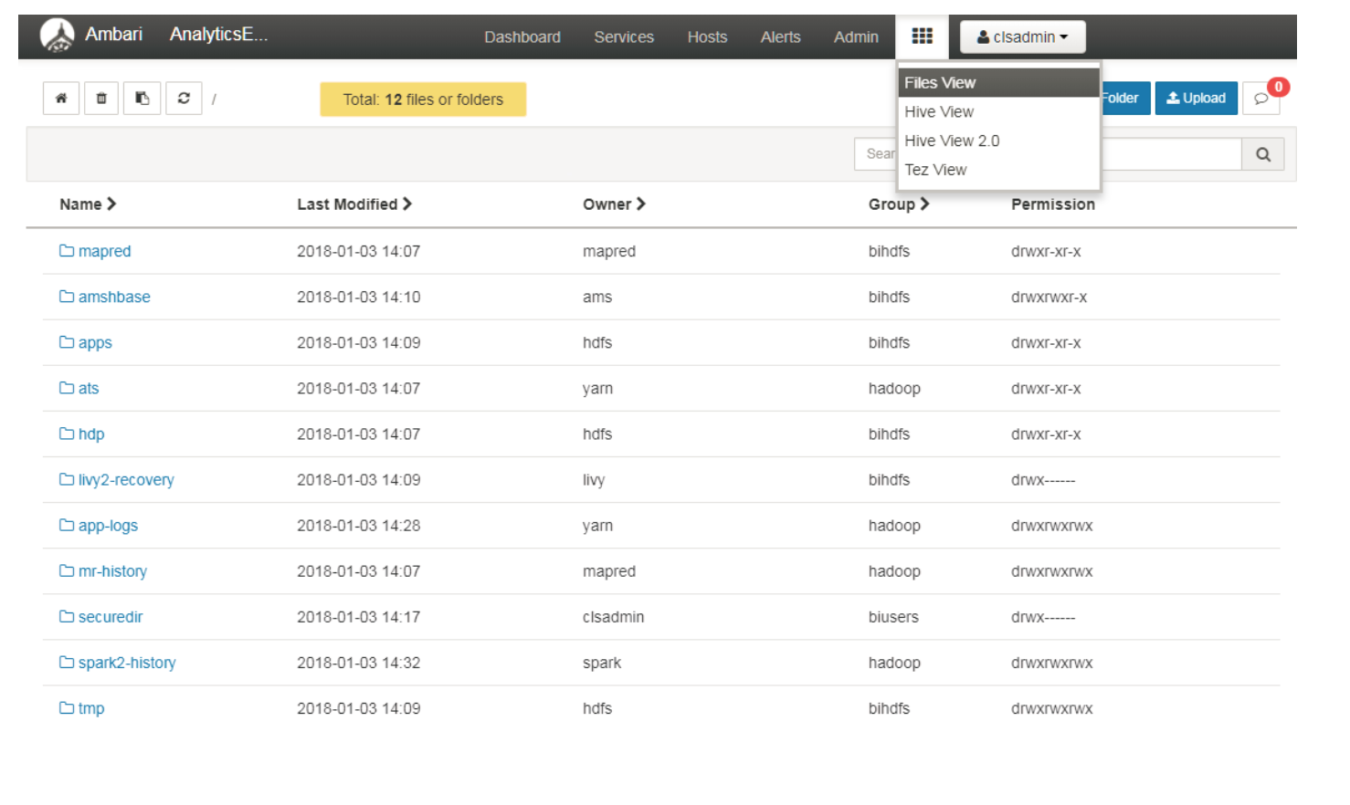
Launch the Ambari console

Slide 16
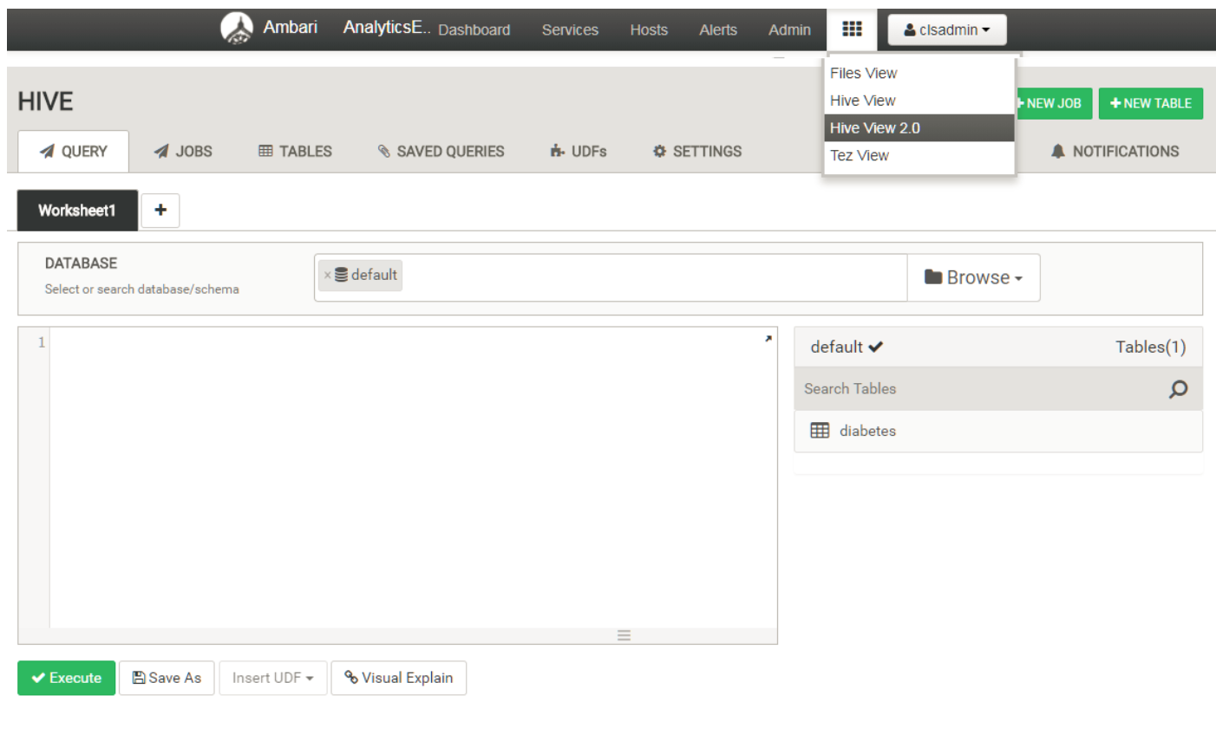
Start Using the services

Slide 17
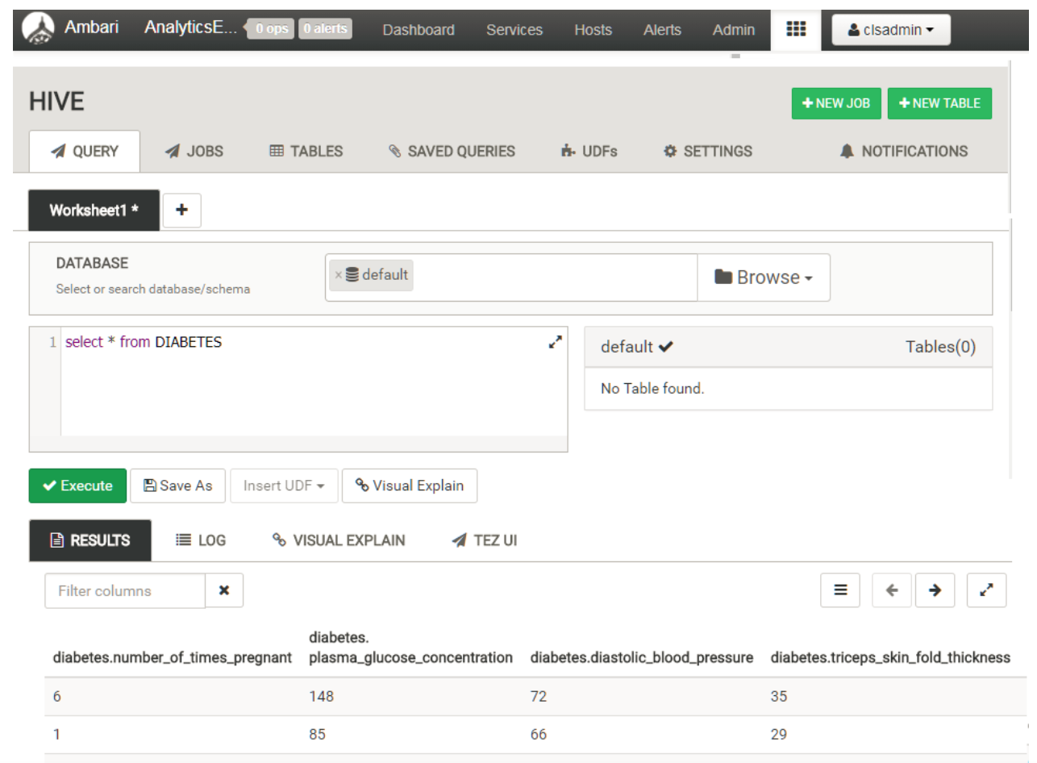

Slide 18
References
https://developer.ibm.com/clouddataservices/docs/analytics-engine/
https://cloud.ibm.com/docs/AnalyticsEngine?topic=AnalyticsEngine-getting-started
https://developer.ibm.com/recipes/tutorials/big-data-and-hadoop-on-ibm-cloud/

Slide 19
Thanks!
Write to me at poholkar@in.ibm.com
Connect with me at https://www.linkedin.com/in/poojaholkar/

